Slide 1
Cloud Computing and Big Data Big Data Pulling it all together
Oxford University
Software Engineering Programme
July 2017

Slide 2
Contents
Understanding the bigger picture
What are the different components
Message queueing and collection systems
Map-Reduce and DAG systems
Realtime Systems
Fast databases for speed
Visualisation and Dashboards

Slide 3

The big picture
Visualisation System
NoSQL or SQL database
Visualisation Store
DAG pipeline Map-Reduce Micro-batch etc
Realtime
Master data
Storage
Data collection models, queueing
The World

Slide 4
The big picture
You have immutable master data
You create a set of processes to:
Collect that data
Store master data
Process data
Visualise and present
Some of those processes act on batch and others on real-time data

Slide 5
How to choose the components?
Two main approaches:
Best of breed
Choose the best available component in each space
Stack
Choose a curated stack that a team or organization is providing/selling/supporting

Slide 6
Approach
Minimise the pain
Choose what you need when you need it
Don’t over engineer

Slide 7
How do I ingest data?
File transfer
Live stream
Sockets
Syslog
Messaging system
From existing databases

Slide 8
How do I store data?
HDFS
Cassandra File System
NoSQL database only
Mongo / HBase / Cassandra
zFS / GlusterFS / NFS etc

Slide 9
How do I process data?
Simple Map Reduce
Hive / Pig
DAG
Pipeline
etc

Slide 10
How do I visualise data
From a SQL database?
From a NoSQL database?
Generate charts in Python Spark?
Etc?

Slide 11
Collection / Queuing systems
Two ways of making the choice
The protocol
The middleware
Protocols
ZeroMQ, MQTT, AMQP, STOMP, Kafka Protocol, Rendevouz, etc
Middleware
Kafka, Apollo, Mosquitto, QPid, MQ, Tibco, WSO2, etc

Slide 12

Apache Kafka
Source: http://www.slideshare.net/charmalloc/

Slide 13
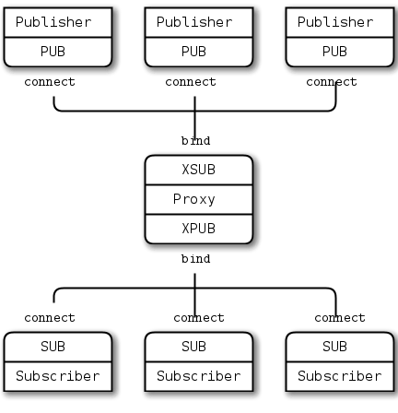
ZeroMQ

Slide 14
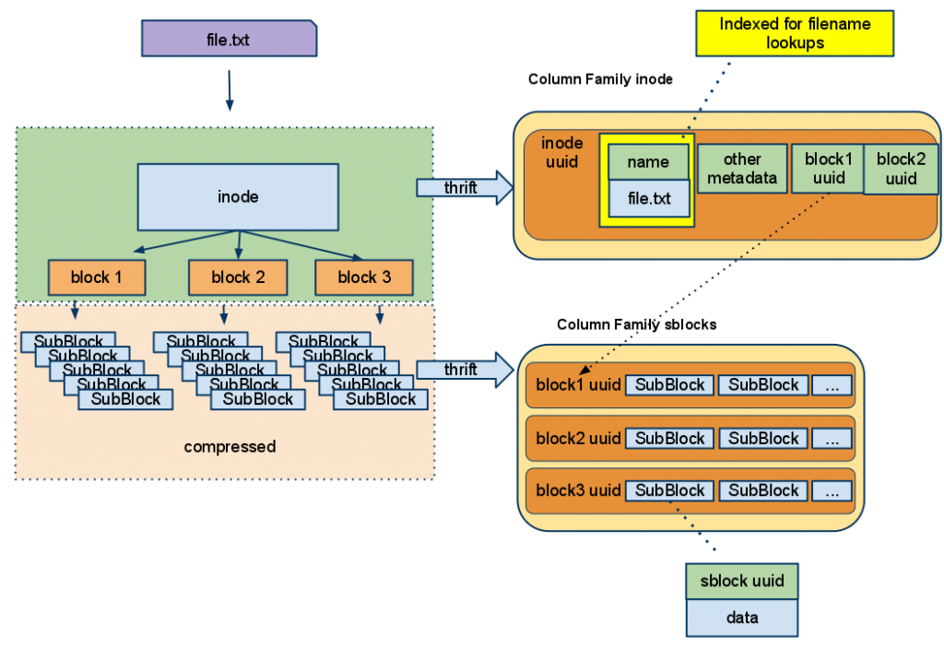
CassandraFS (not open source)

Slide 15
Processing approaches
Covered in detail already
Hadoop
Spark
Tez
etc

Slide 16
Cluster management systems for Big Data
YARN
Part of Hadoop but significantly rebuilt since Hadoop 1
Mesos
Popular Apache project
Built to be a resource manager for a complete datacenter
Supports many workloads (e.g. Docker as well as Spark)

Slide 17
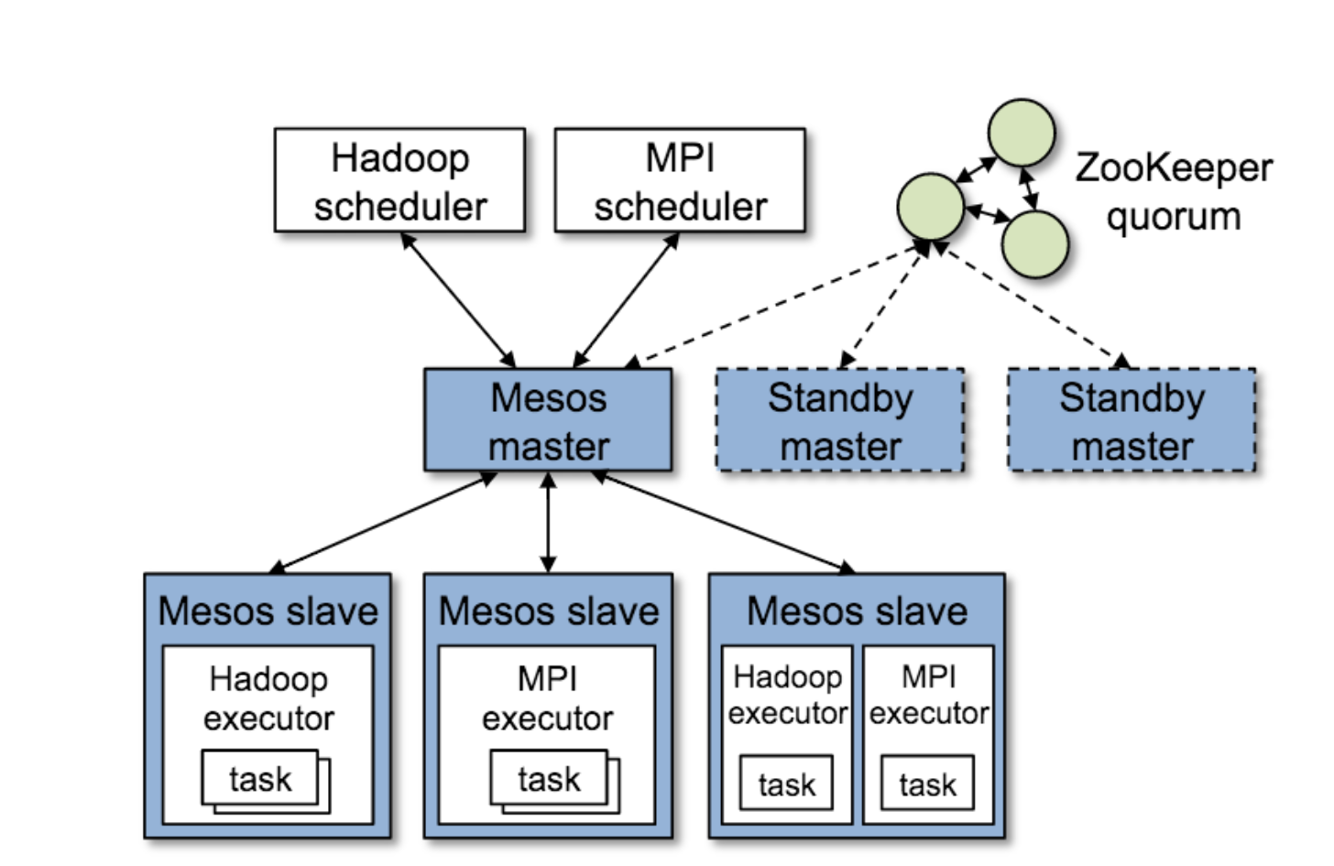
Apache Mesos

Slide 18
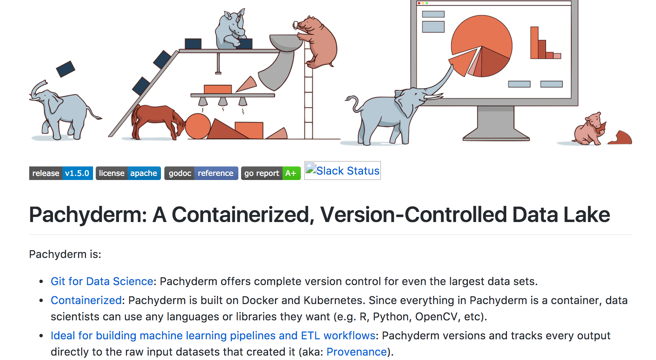
Pachyderm https://github.com/pachyderm/pachyderm

Slide 19
Realtime
Apache Storm
Highly flexible model
Supports pure streaming and micro-batch
Lots of plugins
Apache Spark
Micro-batch only
Integrates cleanly into Spark (fewer components)
Some plugins and more being developed

Slide 20
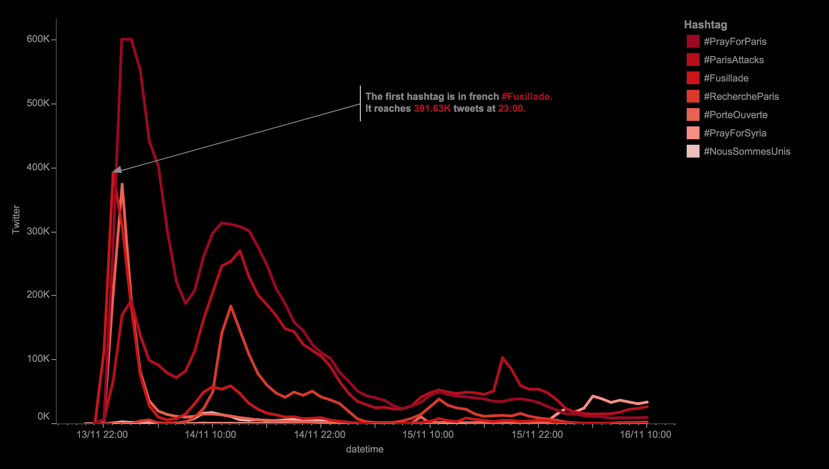
Visualisation

Slide 21
Visualisation approaches
Full products
Tableau, Qlik, SAS, GoodData
Web-based systems
Tableau Public, Datawrapper, Raw, Plotly
Developer oriented
D3.js, dygraphs, Python charting, Leaflet, Fusion Charts, Google Charts, etc

Slide 22
Fortune top 10 big data companies fortune.com/2014/06/13/these-big-data-companies-are-ones-to-watch/
MapR – Apache Hadoop
MemSQL
Databricks – Apache Spark
Platfora – Apache Hadoop
Splunk
Teradata – Apache Hadoop
Palantir – Hadoop, Cassandra, Lucene
Premise
Datameer – Apache Hadoop
Cloudera – Apache Hadoop
Hortonworks – Apache Hadoop
MongoDB – MongoDB
Trifacta – Apache Hadoop
Rapid Web Application Development with MongoDB and the JVM – Trisha Gee – Tuesday 16:15

Slide 23
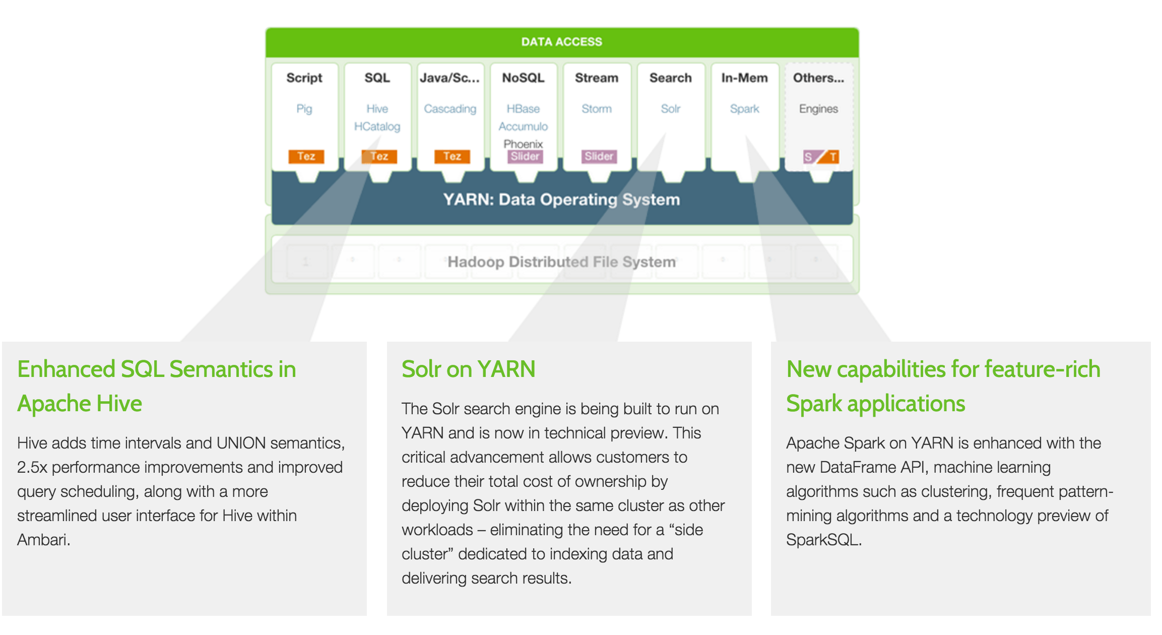
Hortonworks

Slide 24
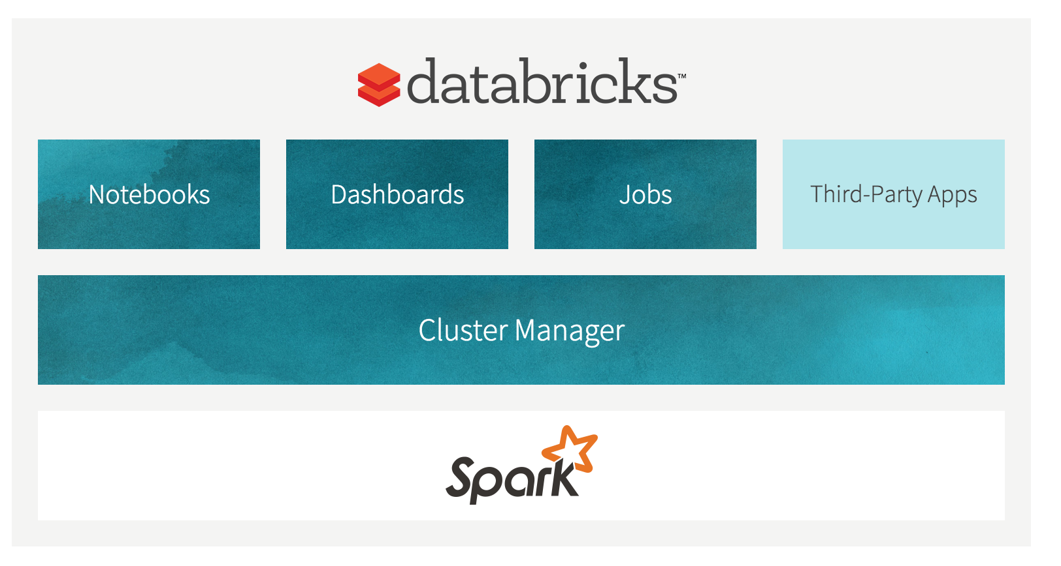
Databricks

Slide 25
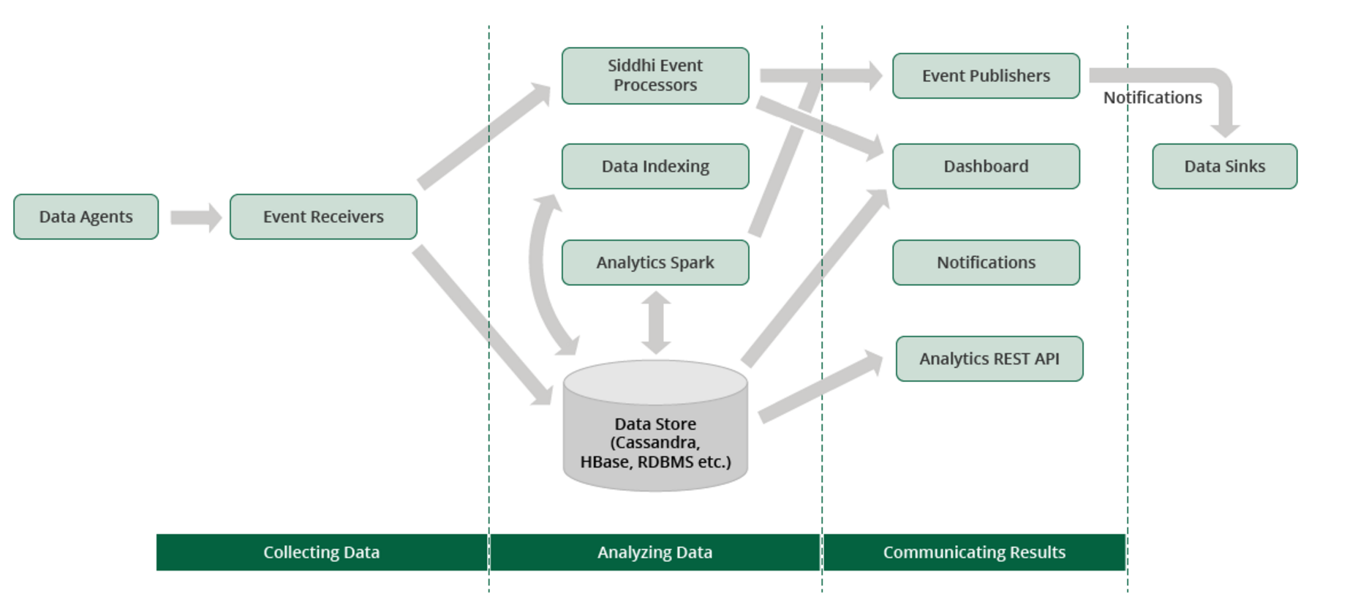
WSO2 DAS

Slide 26
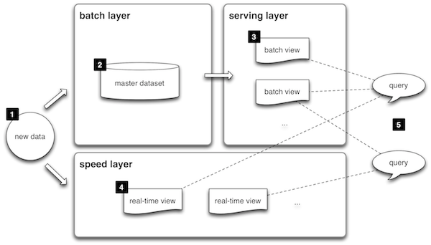
Lambda

Slide 27
The real answer
You are on the bleeding edge
Expect to have some pain

Slide 28
Questions?

